Slide 1


EGYPTIAN RUSSIAN UNIVERSITY
AI Recruitment & Resume Screening
Prepared by:
Youssef Emad, ID: 225241
Omar Tokal, ID: 225238
Amr Hamdy, ID: 225182
Zeyad Mostafa, ID: 225070

Slide 2
Problem Statement
Slow Process
Manual resume screening is time-consuming and repetitive, leading to delays in the hiring process and affecting overall productivity.
Addressing the Challenges in Recruitment Screening
Inconsistent Formats
Differing CV formats and wording across candidates create complications in evaluation, making it difficult for recruiters to compare qualifications effectively.
Semantic Gaps
Keyword screening often overlooks semantic meaning, resulting in potential misjudgments about candidates' skills and experiences relevant to job roles.

Slide 3

Project Objectives
01
02
03
04
05
The system will upload and parse various CV formats efficiently.
It will rank candidates by comparing CVs to job descriptions.
The tool will detect biased wording in job descriptions for fairness.
It will generate synthetic CVs for demonstration and testing purposes.
The system will transform resume writing styles for improved presentation.

Slide 4
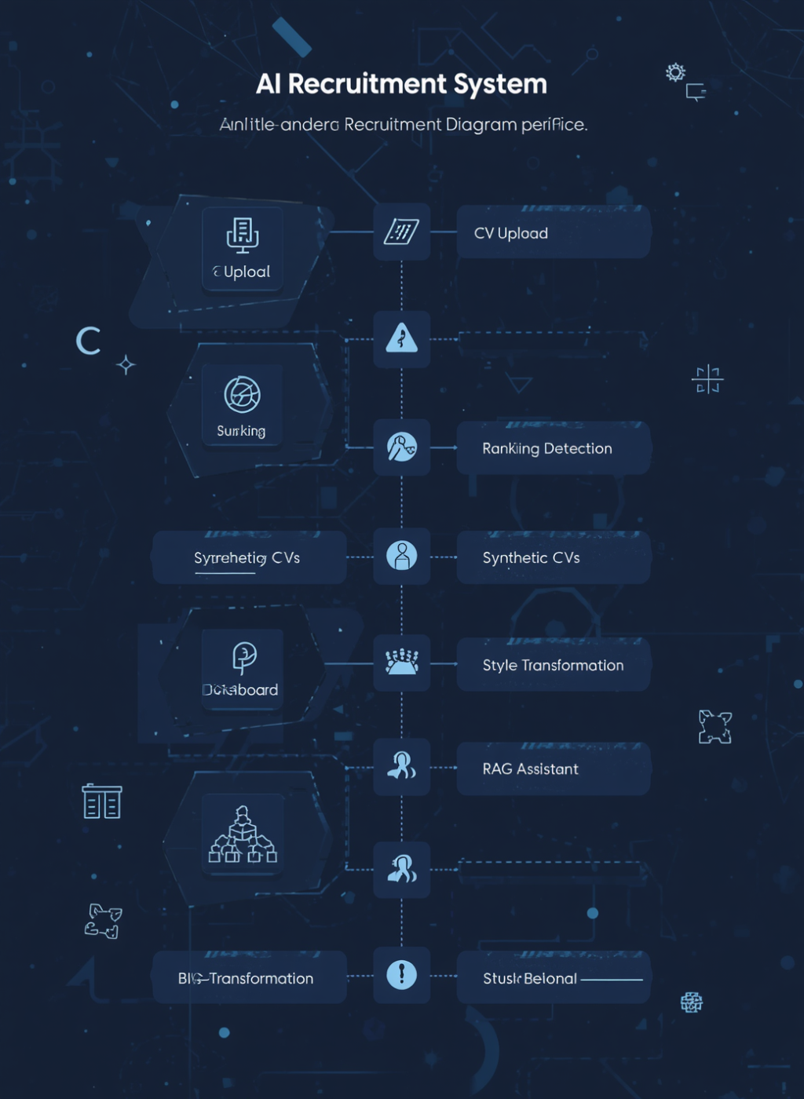
System Workflow Overview
Connecting AI Modules for Recruitment Efficiency
This system integrates multiple AI modules into a cohesive workflow, facilitating seamless CV uploads, parsing, ranking, bias detection, synthetic CV generation, and interactive querying through the RAG assistant interface.

Slide 5
System Architecture
The system architecture encompasses several key components:
Streamlit UI: Serves as the central interface connecting all modules.
Parsing Service: Handles CV uploads and data extraction.
Ranking Service: Compares job descriptions with CVs using AI techniques.
Bias Detection Service: Analyzes job wording for fairness.
Synthetic CV Generation: Creates demo CVs for testing.
Style Transformation Module: Rewrites resumes without altering factual content.
RAG Assistant: Facilitates question answering based on CV context.
Storage: Manages local data and processed outputs.

Slide 6
Dataset Overview
Key Data Insights
Unique CVs
Structured Records
Privacy Assurance
The project utilizes 20 unique Data Engineer CVs for testing purposes, showcasing a variety of skills and experiences relevant to the data engineering field to ensure comprehensive evaluation.
Each CV is meticulously parsed into structured records, enabling efficient analysis and comparison against job descriptions, while maintaining clarity and accessibility of the data for further processing.
We prioritize data privacy; therefore, private CV details are not disclosed in documentation or screenshots, ensuring that sensitive information remains protected throughout the demonstration and testing phases.

Slide 7

Resume Ranking Module
Job Description Matching
This module compares user-submitted job descriptions with uploaded CVs, utilizing OpenAI embeddings for accurate ranking, ensuring a comprehensive analysis of skills and qualifications.

Slide 8


Bias Detection Module
Ensuring Fair Recruitment
The Bias Detection Module analyzes job descriptions for biased language, suggesting neutral alternatives to promote fairness, inclusivity, and a diverse candidate pool throughout the recruitment process.

Slide 9



Synthetic CV Generation
Simulated CV Data
This module generates realistic synthetic CVs for demonstration purposes, offering structured records that simulate candidate profiles without revealing any private information.

Slide 10

Resume Style Transformation
Enhancing resume presentation effectively
The system allows users to upload resumes and transforms them into professional, ATS-friendly, or concise styles, improving wording while preserving original facts without altering experience or qualifications.

Slide 11



RAG Assistant Overview
Understanding Context Retrieval
The RAG Assistant enhances recruitment by allowing users to ask contextual questions based on CV data, ensuring accurate responses grounded in relevant information.

Slide 12
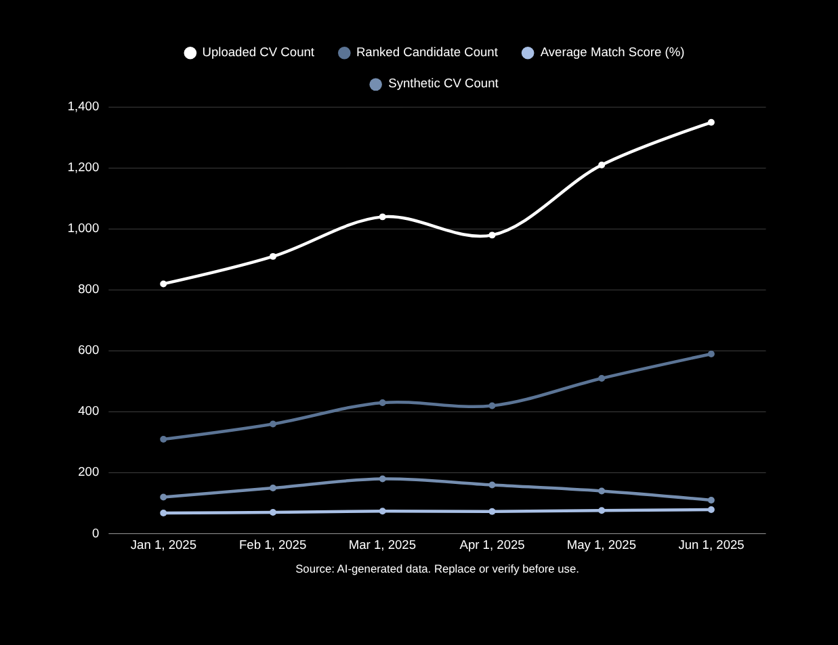
Responsible AI Decision Support
Human-centered recruitment review with explainable AI outputs
The system supports recruiters with ranking scores, bias checks, RAG-based evidence, and dashboard metrics. It helps organize review, but final hiring decisions remain the responsibility of human reviewers.

Slide 13
Results and Testing Summary
01
02
03
04
The system processed 20 CV records successfully without failures.
It generated 35 synthetic CVs for testing and demonstration.
Average match score across candidates was 52.8%, indicating relevance.
The system's functionality was validated through a 200 OK response.

Slide 14

What’s Next for AI?
Exploring future advancements in recruitment technology together

Slide 15
THANK YOU FOR YOUR TIME AND FOR LISTENING.

